Slide 1

MetroGuard AI
MULTI-EVENT INCIDENT INTELLIGENCE FRAMEWORK FOR SMART METRO SURVEILLANCE
ADD415 PROJECT PHASE I
FIRST REVIEW
Presented By,
ADITHYA CHANDRAN – SPT23AD006
AKHIL P – SPT23AD009
MUHAMMED SHIBIL KP – SPT23AD034
SHEHRUZ MUHAMMED CS – SPT23AD043
Guided By :
Ms. ARYA N S
ASSISTANT PROFESSOR
Dept. of AD
On 08/09/2026

Slide 2
CONTENTS
• Introduction
• Problem Identification
• Motivation
• Objective
• Scope and significance
• Literature Surveys
• Block diagram
• Methodology
• Work Plan
• Gannt Chart
• Resource Identification
• Task allocation
• Conclusion
• References
08/09/2026
AI & DS DEPARTMENT, SIMAT
2

Slide 3
INTRODUCTION
Metro rail systems rely on CCTV for passenger safety and daily operations monitoring.
Existing AI systems detect isolated events independently.
They generate multiple unrelated alerts.
They require manual interpretation by operators.
The framework integrates multiple computer vision techniques into one decision-support system.
08/09/2026
AI & DS DEPARTMENT, SIMAT
3

Slide 4
PROBLEM IDENTIFICATION
• Current AI surveillance systems detect events independently.
• Security personnel must manually correlate scattered alerts.
• Lack of contextual understanding makes incident severity difficult to estimate.
• Repeated, unprioritized alerts lead to alert fatigue.
• A context-aware framework is required to assess risk and prioritize responses.
08/09/2026
AI & DS DEPARTMENT, SIMAT
4

Slide 5
MOTIVATION
Current AI surveillance systems detect events independently, generating multiple isolated alerts for related incidents.
Manual correlation of scattered alerts increases operator workload and response time.
Lack of contextual understanding makes incident severity difficult to assess.
Repeated, unprioritized alerts can lead to alert fatigue and reduced operator efficiency.
A context-aware framework is needed to correlate events, assess risk, and prioritize responses in real time.
08/09/2026
AI & DS DEPARTMENT, SIMAT
5

Slide 6
OBJECTIVE
Integrate YOLO object detection, ByteTrack multi-object tracking and activity recognition.
Correlate related events.
Estimate incident severity and prioritize incidents.
Generate explainable incident reports.
Assist metro operators in decision making.
08/09/2026
AI & DS DEPARTMENT, SIMAT
6

Slide 7
SCOPE AND SIGNIFICANCE
• Metro Stations, Railway Stations, Airports and Bus Terminals.
• Improves passenger safety.
• Reduces operator workload.
• Faster emergency response.
• Supports Smart City surveillance.
08/09/2026
AI & DS DEPARTMENT, SIMAT
7

Slide 8
LITERATURE REVIEW
ABDviaMSIFAT: Abnormal Crowd Behavior Detection Utilizing a Multi-Source Information Fusion Technique [1]
Key Features Introduced:
• Dual visual and motion feature extraction
• Weighted multi-source score fusion
• Individual and group-level behavior recognition
Relevance to Our Project:
• Provides a basis for multi-source incident fusion
• Supports contextual event correlation
• Guides group-level behavior analysis
08/09/2026
AI & DS DEPARTMENT, SIMAT
8

Slide 9
LITERATURE REVIEW
Intelligent Anomaly Detection and Localization With Crowd Density Estimation for Improved Public Safety [2]
Key Features Introduced:
• Crowd-density estimation
• Anomaly localization heatmaps
• Public-safety anomaly analysis
Relevance to Our Project:
• Crowd density can be a risk input
• Supports the crowd module
• Helps localize crowd anomalies
08/09/2026
AI & DS DEPARTMENT, SIMAT
23

Slide 10
LITERATURE REVIEW
Abandoned Object Detection and Classification Using Deep Embedded Vision [3]
Key Features Introduced:
• Deep embedded vision
• Background and feature classification
• Abandoned-object recognition
Relevance to Our Project:
• Supports object classification
• Provides scene-adaptive background cues
• Helps build the abandoned-object module
08/09/2026
AI & DS DEPARTMENT, SIMAT
22

Slide 11
LITERATURE REVIEW
Abnormal Activity Detection and Classification of Bus Passengers With In-Vehicle Image Sensing [4]
Key Features Introduced:
• Abnormal passenger activity detection
• Fighting, falling and suspicious actions
• Public-transport image sensing
Relevance to Our Project:
• Relevant to public-transport safety
• Supports event-category selection
• Guides passenger behavior analysis
08/09/2026
AI & DS DEPARTMENT, SIMAT
39

Slide 12
LITERATURE REVIEW
Towards Surveillance Video-and-Language Understanding: New Dataset, Baselines, and Challenges [5]
Key Features Introduced:
• Surveillance video-language dataset
• Event descriptions and baselines
• Video-to-language understanding
Relevance to Our Project:
• Supports explainable incident summaries
• Improves operator alert clarity
• Guides future report generation
08/09/2026
AI & DS DEPARTMENT, SIMAT
19

Slide 13
LITERATURE REVIEW
A Two-Stage Spatiotemporal CNN-YOLOv9 Framework for High-Precision Real-Time Abandoned Object Detection in Public Surveillance Videos [6]
Key Features Introduced:
• Two-stage CNN-YOLOv9 approach
• Spatio-temporal ownership analysis
• Real-time abandoned-object detection
Relevance to Our Project:
• Supports detect-then-analyse design
• Handles crowded and occluded scenes
• Guides abandoned-object modeling
08/09/2026
AI & DS DEPARTMENT, SIMAT
21

Slide 14
LITERATURE REVIEW
A Multi Object Tracking Framework Based on YOLOv8s and ByteTrack Algorithm [7]
Key Features Introduced:
• YOLO detection with ByteTrack
• Persistent identities across frames
• Multi-object tracking framework
Relevance to Our Project:
• Directly supports our tracking backbone
• Enables temporal event analysis
• Guides identity tracking
08/09/2026
AI & DS DEPARTMENT, SIMAT
31

Slide 15
LITERATURE REVIEW
Leveraging Fusion Methods of Human Pose and Motion Dynamics for Accurate Violence Detection in Video Surveillance [8]
Key Features Introduced:
• Human-pose and motion fusion
• Skeleton and optical-flow features
• Violence feature integration
Relevance to Our Project:
• Supports fight-detection features
• Can complement object detection
• Guides pose-motion fusion
08/09/2026
AI & DS DEPARTMENT, SIMAT
26

Slide 16
LITERATURE REVIEW
Context-aware Video Anomaly Detection in Long-Term Datasets [9]
Key Features Introduced:
• Long-term temporal context
• Context-based anomaly classification
• Video anomaly analysis over extended periods
Relevance to Our Project:
• Shows the value of scene context
• Helps reduce isolated alerts
• Supports temporal incident understanding
08/09/2026
AI & DS DEPARTMENT, SIMAT
9

Slide 17
LITERATURE REVIEW
Spatio-Temporal Semantic Algorithm for Video Anomaly Detection from Monitoring Perspectives [10]
Key Features Introduced:
• Spatial, temporal and semantic features
• Monitoring-oriented anomaly analysis
• Semantic video representation
Relevance to Our Project:
• Supports scene-level understanding
• Motivates multi-context reasoning
• Helps combine spatial and temporal cues
08/09/2026
AI & DS DEPARTMENT, SIMAT
13

Slide 18
LITERATURE REVIEW
Graph-Based Knowledge Driven Approach for Violence Detection [11]
Key Features Introduced:
• Spatial-temporal knowledge graphs
• Graph-based violence reasoning
• Knowledge-driven event representation
Relevance to Our Project:
• Supports context fusion
• Helps higher-level incident reasoning
• Guides graph-based incident representation
08/09/2026
AI & DS DEPARTMENT, SIMAT
12

Slide 19
LITERATURE REVIEW
Action Knowledge Graph for Violence Detection Using Audiovisual Features [12]
Key Features Introduced:
• Knowledge graph for violence context
• Audiovisual feature fusion
• Action relationship modeling
Relevance to Our Project:
• Supports relationship-aware reasoning
• Helps describe violent incidents
• Informs incident context modeling
08/09/2026
AI & DS DEPARTMENT, SIMAT
11

Slide 20
LITERATURE REVIEW
Real-Time Video Surveillance Analysis at the Edge in Smart Cities [13]
Key Features Introduced:
• Edge AI for real-time video
• Detection, tracking and event correlation
• Low-latency smart-city surveillance
Relevance to Our Project:
• Supports low-latency deployment
• Fits CCTV-based metro systems
• Guides edge surveillance design
08/09/2026
AI & DS DEPARTMENT, SIMAT
10

Slide 21
LITERATURE REVIEW
VD-Net: An Edge Vision-Based Surveillance System for Violence Detection [14]
Key Features Introduced:
• Lightweight edge violence detection
• Low-compute real-time design
• Edge-based surveillance system
Relevance to Our Project:
• Supports near-real-time fight detection
• Fits edge deployment needs
• Guides lightweight model design
08/09/2026
AI & DS DEPARTMENT, SIMAT
27

Slide 22
LITERATURE REVIEW
An Attention-Based Unsupervised Framework for Video Anomaly Detection in Large Heterogeneous Environments [15]
Key Features Introduced:
• Attention-based anomaly regions
• Unsupervised learning for CCTV
• Handling heterogeneous environments
Relevance to Our Project:
• Helps handle diverse camera views
• Reduces label requirements
• Supports robust anomaly detection
08/09/2026
AI & DS DEPARTMENT, SIMAT
15

Slide 23
LITERATURE REVIEW
Real-Time Human Group Detection and Clustering in Crowded Environments Using Enhanced Multi-Object Tracking [16]
Key Features Introduced:
• Enhanced multi-object tracking
• Proximity and trajectory clustering
• Real-time group detection
Relevance to Our Project:
• Adds group-level context
• Complements ByteTrack tracking
• Supports crowded-scene analysis
08/09/2026
AI & DS DEPARTMENT, SIMAT
24

Slide 24
LITERATURE REVIEW
Multi-Scale Video Anomaly Detection by Multi-Grained Spatio-Temporal Representation Learning [17]
Key Features Introduced:
• Multi-scale spatio-temporal features
• Local and global anomaly learning
• Multi-grained video representation
Relevance to Our Project:
• Useful for people, crowds and objects
• Supports multi-level event analysis
• Guides spatio-temporal feature design
08/09/2026
AI & DS DEPARTMENT, SIMAT
14

Slide 25
LITERATURE REVIEW
CFTformer: End-to-End Cross-Frame Multi-Object Tracking With Transformer [18]
Key Features Introduced:
• Cross-frame transformer tracking
• Trajectory refinement and attention
• End-to-end multi-object tracking
Relevance to Our Project:
• Suggests a future tracking upgrade
• Helps reduce identity switches
• Supports advanced tracking research
08/09/2026
AI & DS DEPARTMENT, SIMAT
32

Slide 26
LITERATURE REVIEW
SCL-YOLOv11: A Lightweight Object Detection Network for Low-Illumination Environments [19]
Key Features Introduced:
• Lightweight YOLOv11 for low light
• Image enhancement and distillation
• Low-illumination object detection
Relevance to Our Project:
• Supports poorly lit metro scenes
• Improves robust object detection
• Guides low-light deployment
08/09/2026
AI & DS DEPARTMENT, SIMAT
35

Slide 27
LITERATURE REVIEW
Online Action Detection by Long Short-Term Transformer with Query Exemplars [20]
Key Features Introduced:
• Long Short-Term Transformer
• Online temporal action detection
• Query exemplar mechanism
Relevance to Our Project:
• Supports streaming event analysis
• Useful for fight localization
• Guides online action recognition
08/09/2026
AI & DS DEPARTMENT, SIMAT
34

Slide 28
LITERATURE REVIEW
Abandoned Bag Detection in Public Areas Using Grounding DINO With Fine-Grained Prompts [21]
Key Features Introduced:
• Grounding DINO with fine-grained prompts
• Carry-place-leave-stationary sequence
• Person-object association
Relevance to Our Project:
• Shapes abandoned-object state logic
• Supports object-person association
• Helps model object ownership
08/09/2026
AI & DS DEPARTMENT, SIMAT
20

Slide 29
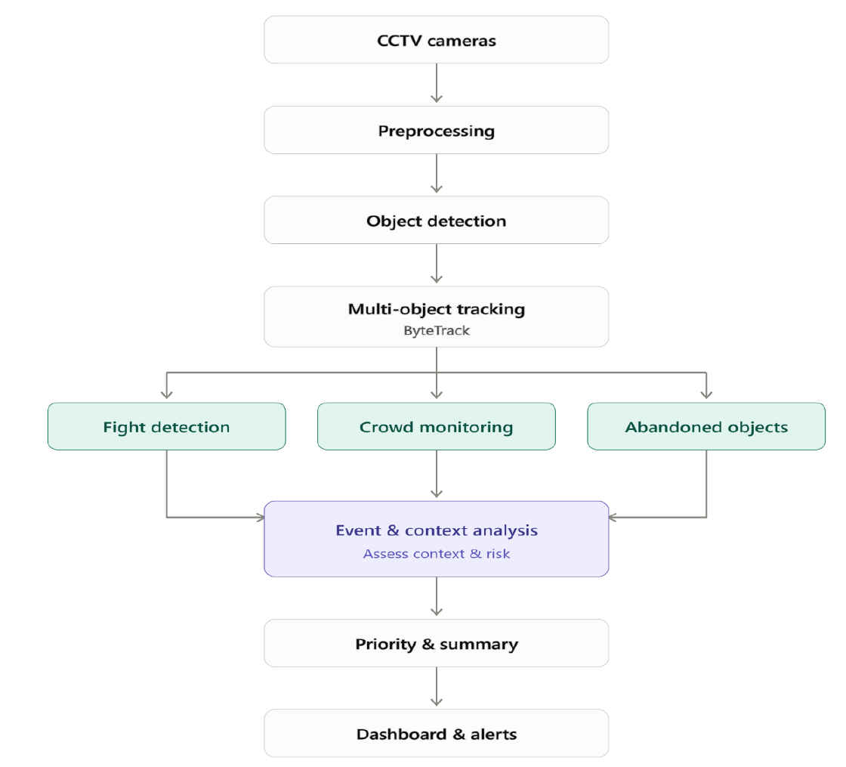
BLOCK DIAGRAM
08/09/2026
AI & DS DEPARTMENT, SIMAT
40

Slide 30
METHODOLOGY
• CCTV feeds are processed through preprocessing.
• YOLOv11 detects people and objects in each frame.
• ByteTrack follows detected entities across frames.
• Fight, crowd and abandoned-object modules run in parallel.
• Event and context analysis assesses context and risk.
• The system generates priority level and incident summary.
• Results are pushed to an interactive dashboard for real-time alerts.
08/09/2026
AI & DS DEPARTMENT, SIMAT
41

Slide 31
WORK PLAN
Phase | Major Tasks
1 | Literature study and requirements
2 | Dataset preparation
3 | Detection and tracking modules
4 | Incident reasoning and risk assessment
5 | Dashboard and system integration
6 | Testing, evaluation and documentation
08/09/2026
AI & DS DEPARTMENT, SIMAT
42

Slide 32
GANNT CHART
SEP
OCT
NOV
DEC
JAN
FEB
MAR
APR
Literature & requirements
Dataset preparation
Detection modules
Tracking & event extraction
Incident reasoning & risk
Dashboard & integration
Testing & evaluation
Report & final presentation
08/09/2026
AI & DS DEPARTMENT, SIMAT
43

Slide 33
RESOURCE IDENTIFICATION
• Development PC / GPU system
• CCTV or recorded video source
• Storage for datasets and video clips
• Python and deep-learning libraries
• Ultralytics YOLOv11 and ByteTrack
• OpenCV and dashboard tools
• Public surveillance datasets
08/09/2026
AI & DS DEPARTMENT, SIMAT
44

Slide 34
TASK ALLOCATION
ADITHYA CHANDRAN : System architecture, YOLOv11 integration and dashboard.
AKHIL P : Dataset preparation, abandoned-object module and model training.
MUHAMMED SHIBIL KP : Literature review, ByteTrack/tracking and fight-detection module.
SHEHRUZ MUHAMMED CS : Incident reasoning, context fusion, risk assessment and report.
ALL MEMBERS : Testing, documentation and final presentation preparation.
08/09/2026
AI & DS DEPARTMENT, SIMAT
45

Slide 35
CONCLUSION
• The framework unifies multi-event detection, tracking and risk assessment.
• It detects multiple event types from CCTV.
• It prioritizes incidents using risk assessment.
• It supports faster and smarter security response.
• It is scalable for future smart transportation systems.
08/09/2026
AI & DS DEPARTMENT, SIMAT
46

Slide 36
REFERENCES
[1] A. A. Hamid, S. A. Monadjemi, and B. Shoushtarian, “ABDviaMSIFAT: Abnormal Crowd Behavior Detection Utilizing a Multi-Source Information Fusion Technique,” IEEE Access, vol. 13, pp. 75000–75019, 2025, doi: 10.1109/ACCESS.2024.3436007
.
[2] D. Chaudhary, S. Kumar, and V. S. Dhaka, “Intelligent Anomaly Detection and Localization With Crowd Density Estimation for Improved Public Safety,” IEEE Access, vol. 13, pp. 169912–169928, 2025, doi: 10.1109/ACCESS.2025.3614146.
[3] A. M. Qasim, N. Abbas, A. Ali, and B. A. A. Al-Ghamdi, “Abandoned Object Detection and Classification Using Deep Embedded Vision,” IEEE Access, vol. 12, pp. 35539–35551, 2024, doi: 10.1109/ACCESS.2024.3369233.
[4] H.-Y. Lin and C.-H. Tseng, “Abnormal Activity Detection and Classification of Bus Passengers With In-Vehicle Image Sensing,” IEEE Access, 2024, doi: 10.1109/ACCESS.2024.3365138.
[5] T. Yuan, X. Zhang, K. Liu, B. Liu, C. Chen, J. Jin, and Z. Jiao, “Towards Surveillance Video-and-Language Understanding: New Dataset, Baselines, and Challenges,” in Proc. IEEE/CVF CVPR, 2024, pp. 22052–22061, doi: 10.1109/CVPR52733.2024.02082.
[6] S. F. A. Shah, M. Q. Khan, A. A. Alsuwaylimi, and L. A. Alenezi, “A Two-Stage Spatiotemporal CNN-YOLOv9 Framework for High-Precision Real-Time Abandoned Object Detection in Public Surveillance Videos,” IEEE Access, vol. 14, pp. 35983–35997, 2026, doi: 10.1109/ACCESS.2026.3669588.
[7] Y. Wang and V. Y. Mariano, “A Multi Object Tracking Framework Based on YOLOv8s and ByteTrack Algorithm,” IEEE Access, 2024, doi: 10.1109/ACCESS.2024.3450370.
[8] S. T. Y. Aung, W. Kusakunniran, and Y. K. Hooi, “Leveraging Fusion Methods of Human Pose and Motion Dynamics for Accurate Violence Detection in Video Surveillance,” IEEE Access, 2025, doi: 10.1109/ACCESS.2025.3613765.
[9] Z. Yang and R. J. Radke, “Context-aware Video Anomaly Detection in Long-Term Datasets,” in Proc. IEEE/CVF CVPR Workshops, 2024, pp. 4002–4011, doi: 10.1109/CVPRW63382.2024.00404.
[10] Z. Zhu, H. He, and M. Wang, “A Spatio-Temporal Semantic Algorithm for Video Anomaly Detection from Monitoring Perspectives,” in Proc. 5th Int. Conf. Artificial Intelligence, Robotics, and Communication (ICAIRC), 2025, doi: 10.1109/ICAIRC68035.2025.11385035.
08/09/2026
AI & DS DEPARTMENT, SIMAT
47

Slide 37
[11] M. Khan, W. Gueaieb, A. Elsaddik, G. De Masi, and F. Karray, “Graph-Based Knowledge Driven Approach for Violence Detection,” IEEE Consumer Electronics Magazine, vol. 14, no. 1, pp. 77–85, 2025, doi: 10.1109/MCE.2024.3446192.
[12] M. Khan, M. Saad, A. Khan, W. Gueaieb, A. E. Saddik, G. De Masi, and F. Karray, “Action Knowledge Graph for Violence Detection Using Audiovisual Features,” in Proc. IEEE Int. Conf. Consumer Electronics (ICCE), 2024, doi: 10.1109/ICCE59016.2024.10444158.
[13] A. S. Kannan, Z. A. Alsalami, A. Nihlani, K. Gowthami, M. A. K. Abdukodir Kizi, A. Amudha, and Z. Mamadalieva, “Real-Time Video Surveillance Analysis at the Edge in Smart Cities,” in Proc. Int. Conf. Innovations and Emerging Technologies in AI & Communication Systems (IETACS), 2025, doi: 10.1109/IETACS68750.2025.11385417.
[14] M. Khan, A. E. Saddik, W. Gueaieb, G. De Masi, and F. Karray, “VD-Net: An Edge Vision-Based Surveillance System for Violence Detection,” IEEE Access, vol. 12, pp. 43796–43808, 2024, doi: 10.1109/ACCESS.2024.3380192.
[15] M. H. Habeb, M. Salama, and L. A. Elrefaei, “An Attention-Based Unsupervised Framework for Video Anomaly Detection in Large Heterogeneous Environments,” in Proc. MIUCC, 2024, doi: 10.1109/MIUCC62295.2024.10783549.
[16] H. Lee, D. Kang, H. Park, S. Park, D. Jeong, and J. Paik, “Real-Time Human Group Detection and Clustering in Crowded Environments Using Enhanced Multi-Object Tracking,” IEEE Access, vol. 12, pp. 184028–184039, 2024, doi: 10.1109/ACCESS.2024.3503661.
[17] M. Zhang, J. Wang, Q. Qi, H. Sun, Z. Zhuang, P. Ren, R. Ma, and J. Liao, “Multi-Scale Video Anomaly Detection by Multi-Grained Spatio-Temporal Representation Learning,” in Proc. IEEE/CVF CVPR, 2024, pp. 17385–17394, doi: 10.1109/CVPR52733.2024.01646.
[18] A. Amirkhani and S. A. Khoshnevis, “CFTformer: End-to-End Cross-Frame Multi-Object Tracking With Transformer,” IEEE Access, 2025, doi: 10.1109/ACCESS.2025.3567349.
[19] S. Zhuo, H. Bai, L. Jiang, X. Zhou, X. Duan, Y. Ma, and Z. Zhou, “SCL-YOLOv11: A Lightweight Object Detection Network for Low-Illumination Environments,” IEEE Access, vol. 13, pp. 47653–47662, 2025, doi: 10.1109/ACCESS.2025.3550947.
[20] H. Zhang, Y. Guo, and X. Du, “Online Action Detection by Long Short-Term Transformer with Query Exemplars,” in Proc. IEEE Int. Joint Conf. Neural Networks (IJCNN), 2024, doi: 10.1109/IJCNN60899.2024.10651333.
[21] T. Soontornnapar, “Abandoned Bag Detection in Public Areas Using Grounding DINO With Fine-Grained Prompts,” in Proc. ECTI-CON, 2025, doi: 10.1109/ECTI-CON64996.2025.11100886.
08/09/2026
AI & DS DEPARTMENT, SIMAT
48

Slide 38
THANK YOU

